Slide 1



UNIT 6; The time of your life
Hobbies

Slide 2
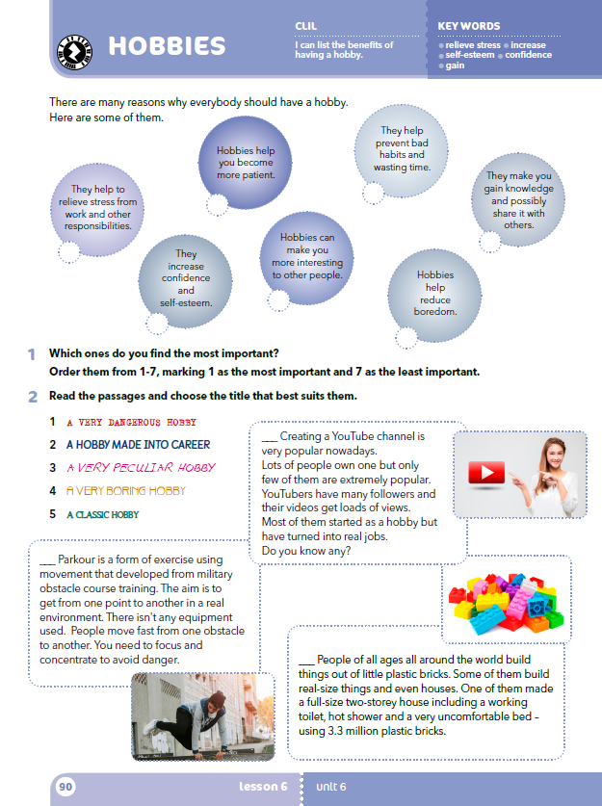
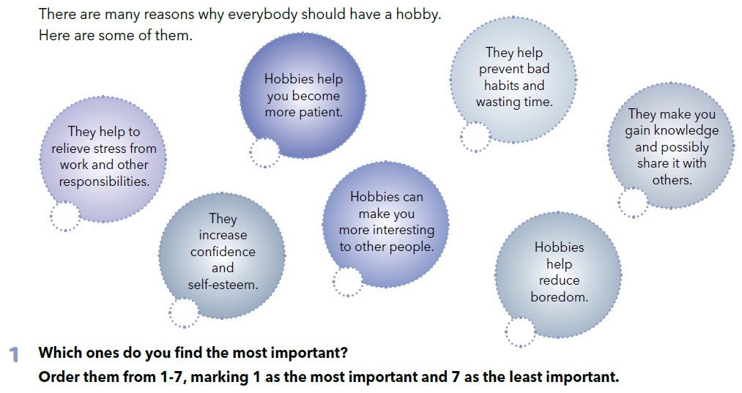

Slide 3
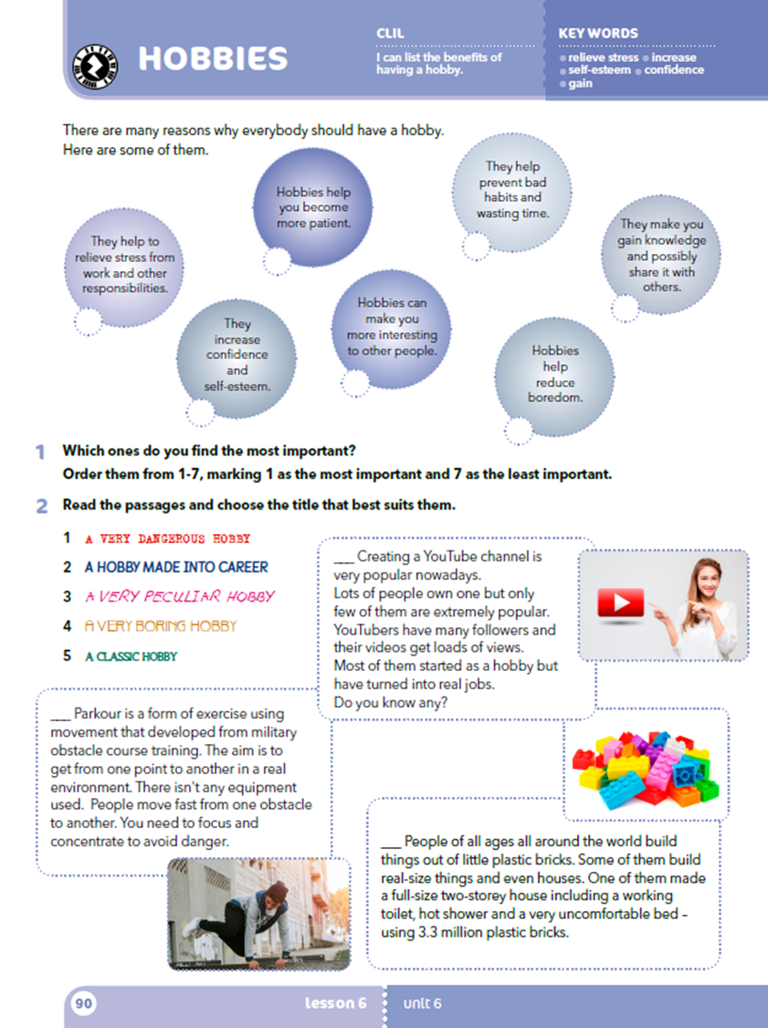
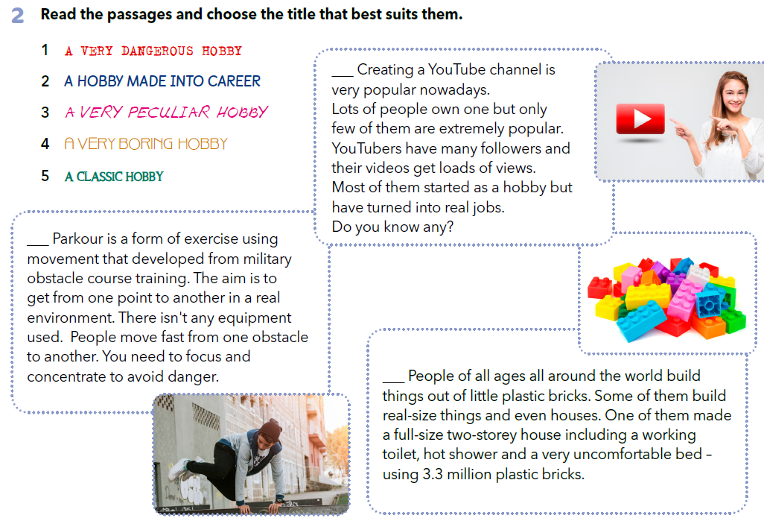

Slide 4
Razgovarajte u paru.
Pitanja započnite upitnim riječima (what, where, how, why, who). Primjerice: A: Who is parkour for? B: It is for sporty people. A: What can you build out of little plastic bricks? B: You can build towers, vehicles, houses, robots etc. A: Why do youtubers become popular? B: They become popular when they are interesting, fun and funny to a lot of people.

Slide 5

LEARN MORE
https://www.e-sfera.hr/dodatni-digitalni-sadrzaji/2cecb829-d591-40dd-9b48-063a6868ae30/
Funny hobbies

